Slide 1
Software-Defined Networking
Lecturer: Ngo Huy Bien
Software Engineering Department
Faculty of Information Technology
VNUHCM - University of Science
Ho Chi Minh City, Vietnam
nhbien@fit.hcmus.edu.vn

Slide 2

Objectives

Slide 3

Contents
OpenFlow-enabled Switches and Routers.

Slide 4

References
Nick McKeown et al. (2008). OpenFlow - Enabling Innovation in Campus Networks.
Martin Casado et al. (2007). Ethane - Taking Control of the Enterprise.
Diego Kreutz et al. (2014). Software-Defined Networking - A Comprehensive Survey.

Slide 5
The Need for Programmable Networks [1]
As researchers, how can we run experiments in our campus networks?
One approach - that we do not take - is to persuade commercial “name-brand” equipment vendors to provide an open, programmable, virtualized platform on their switches and routers so that researchers can deploy new protocols, while network administrators can take comfort that the equipment is well supported.

Slide 6
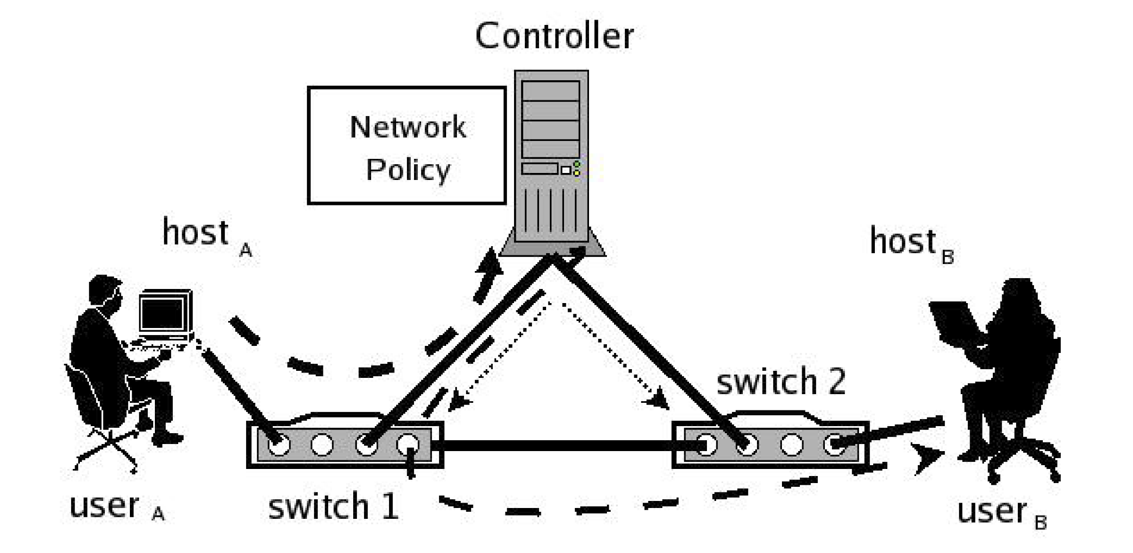
Ethane Network [2]
Example of communication on an Ethane network.
Route setup shown by dotted lines; the path taken by the first packet of a flow shown by dashed lines.

Slide 7
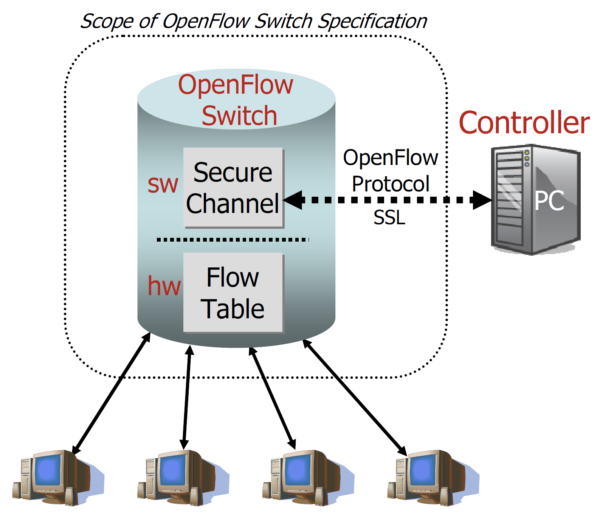
Idealized OpenFlow Switch [1]
Table is controlled by a remote controller via the Secure Channel.

Slide 8
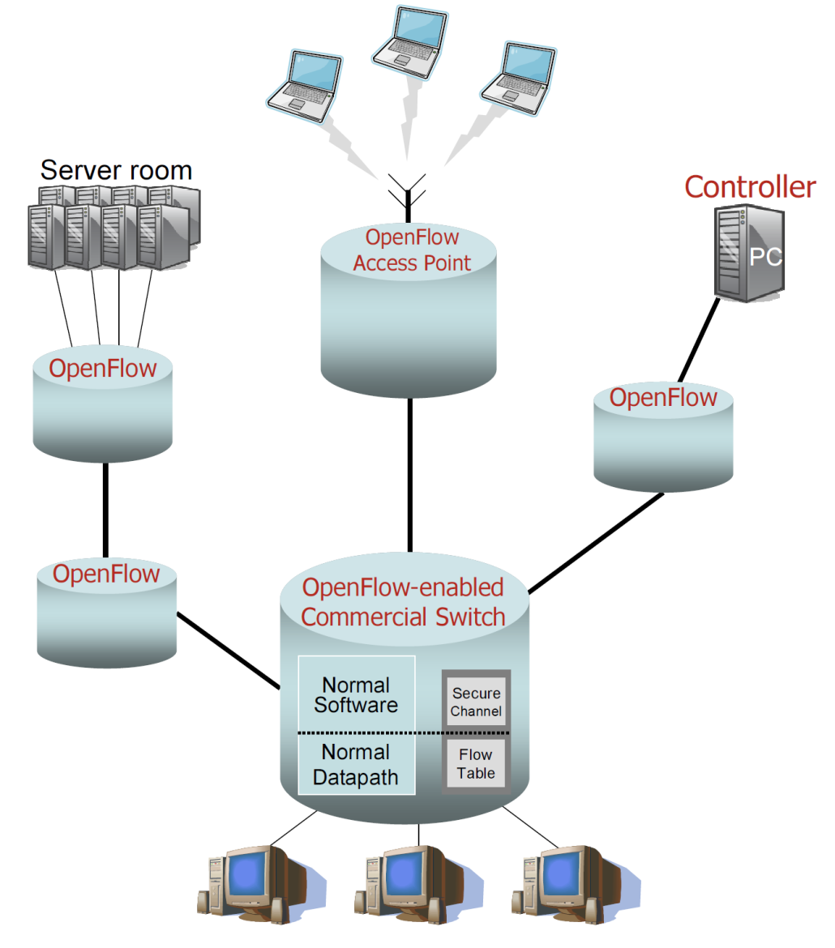
OpenFlow-enabled Commercial Switches and Routers
Example of a network of OpenFlow- enabled commercial switches and routers.

Slide 9
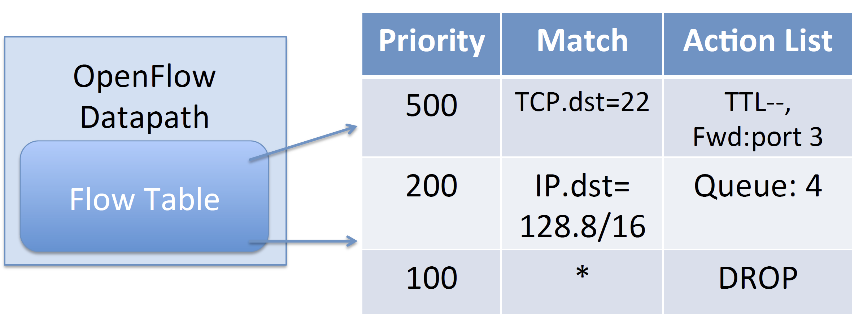
Flow Table

Slide 10
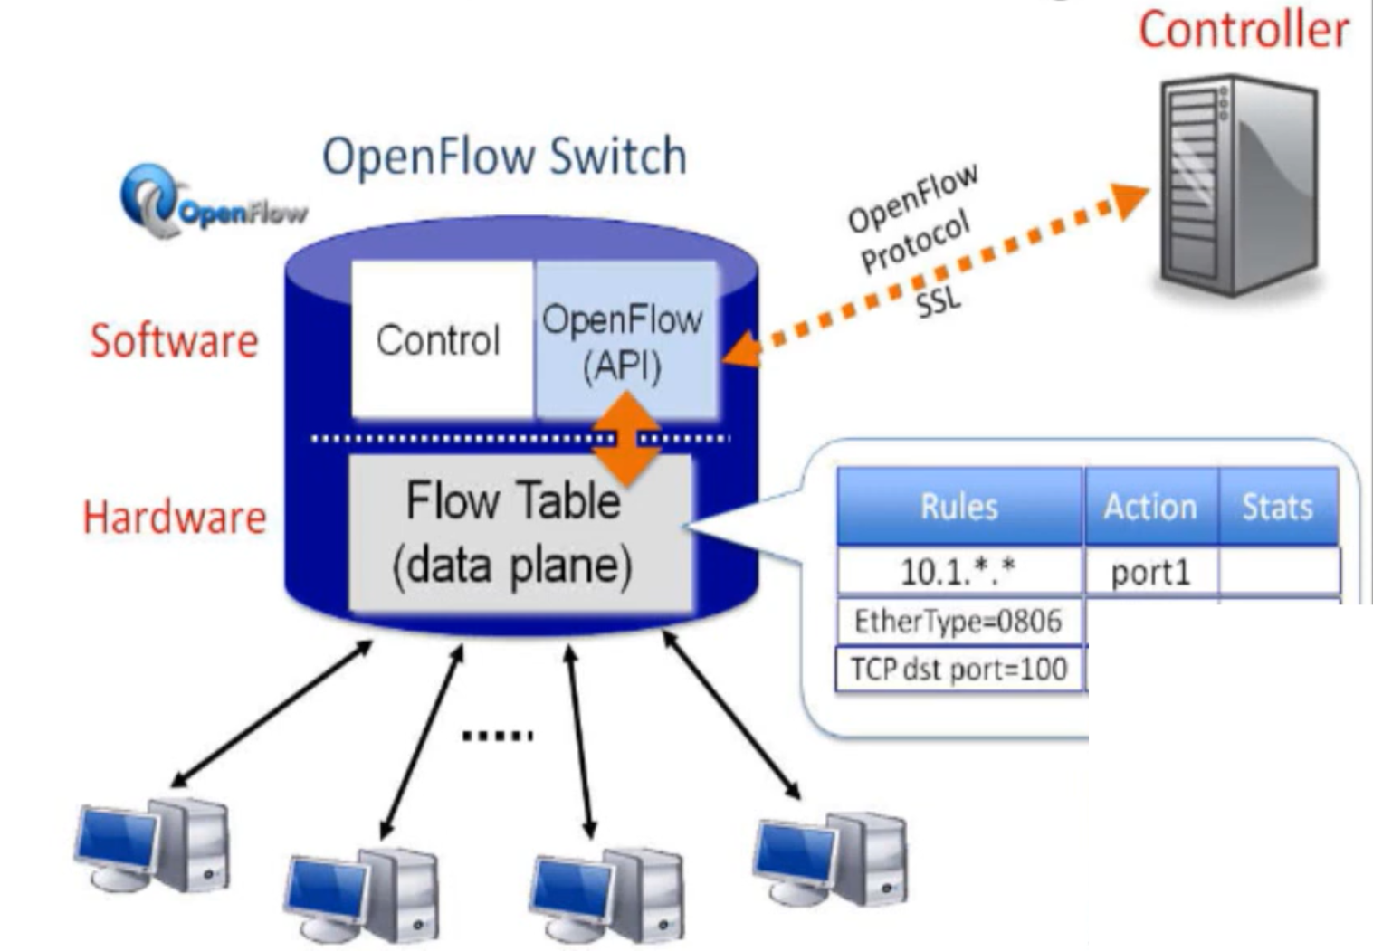
OpenFlow API

Slide 11


Slide 12
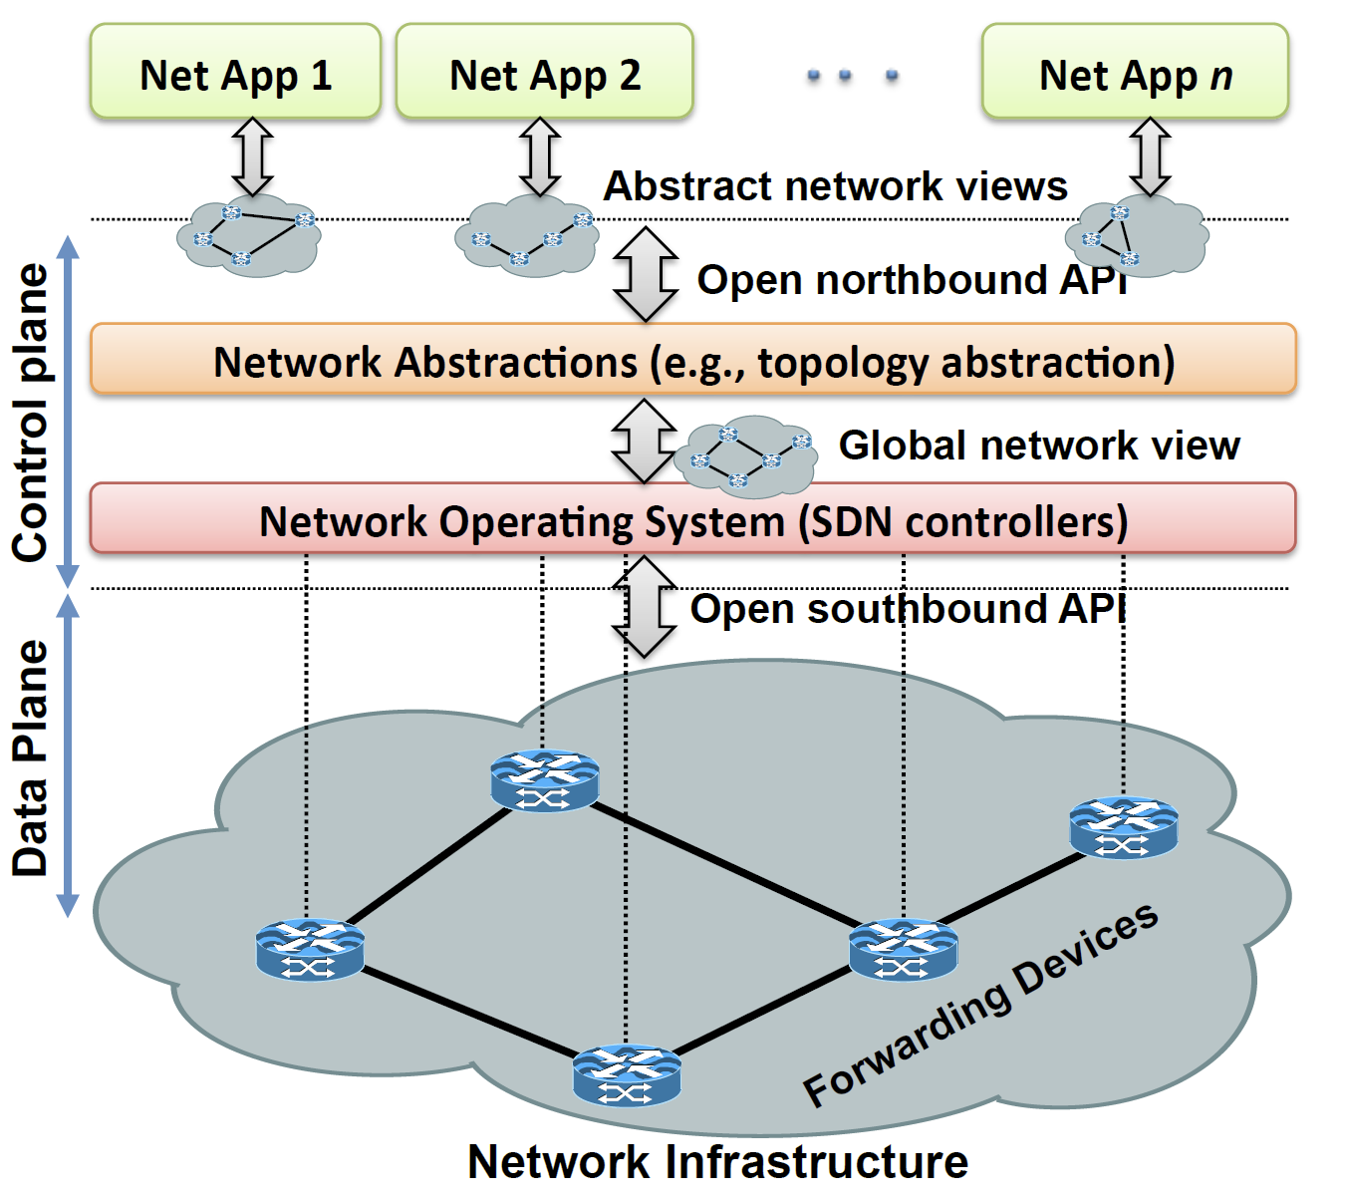
Software-Defined Networking [3]
SDN refers to a network architecture where the forwarding state in the data plane is managed by a remote control plane decoupled from the former.

Slide 13
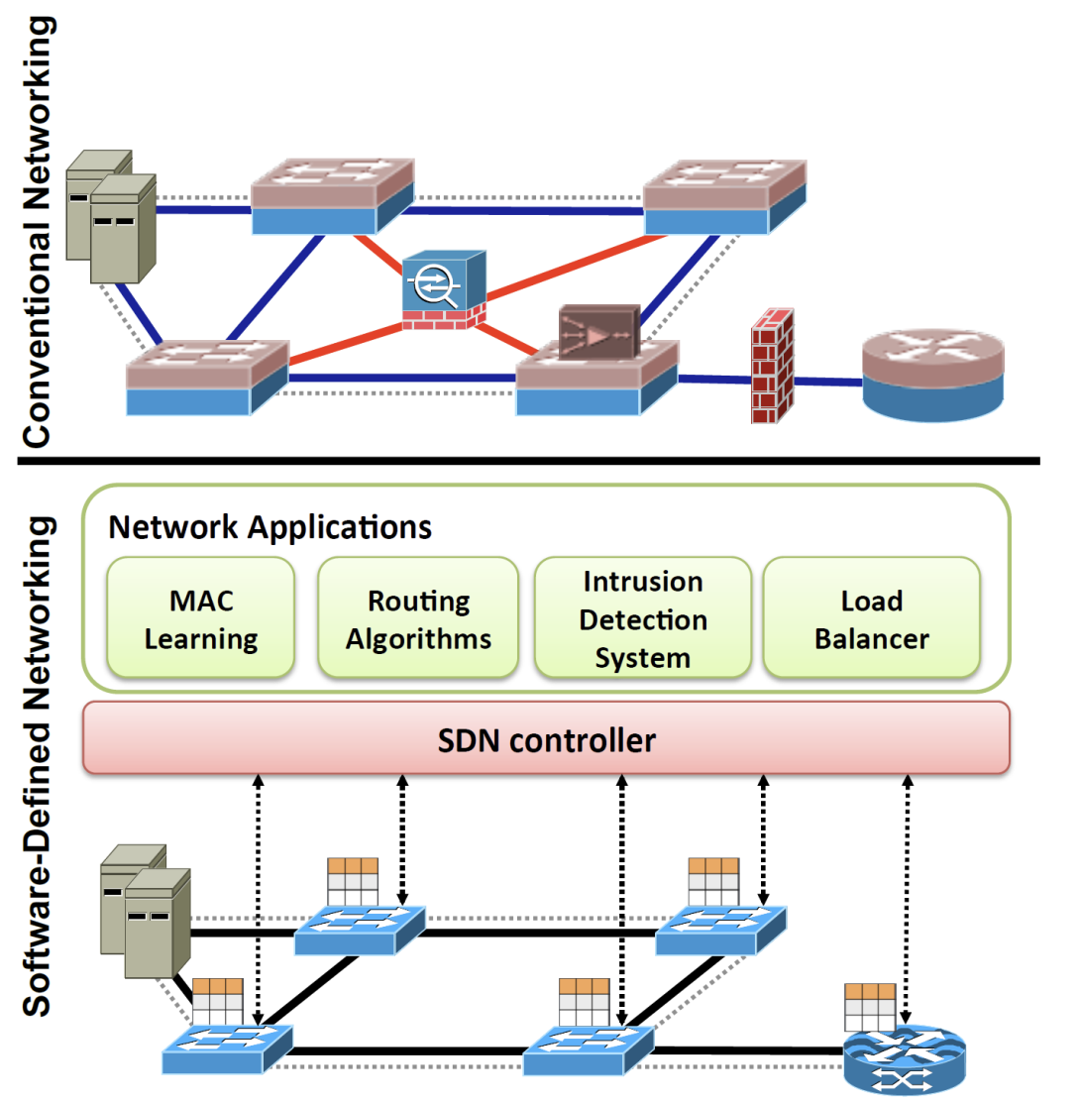
Traditional Networking vs. SDN
Traditional networking versus Software-Defined Networking (SDN).
With SDN, management becomes simpler and middleboxes services can be delivered as SDN controller applications.

Slide 14
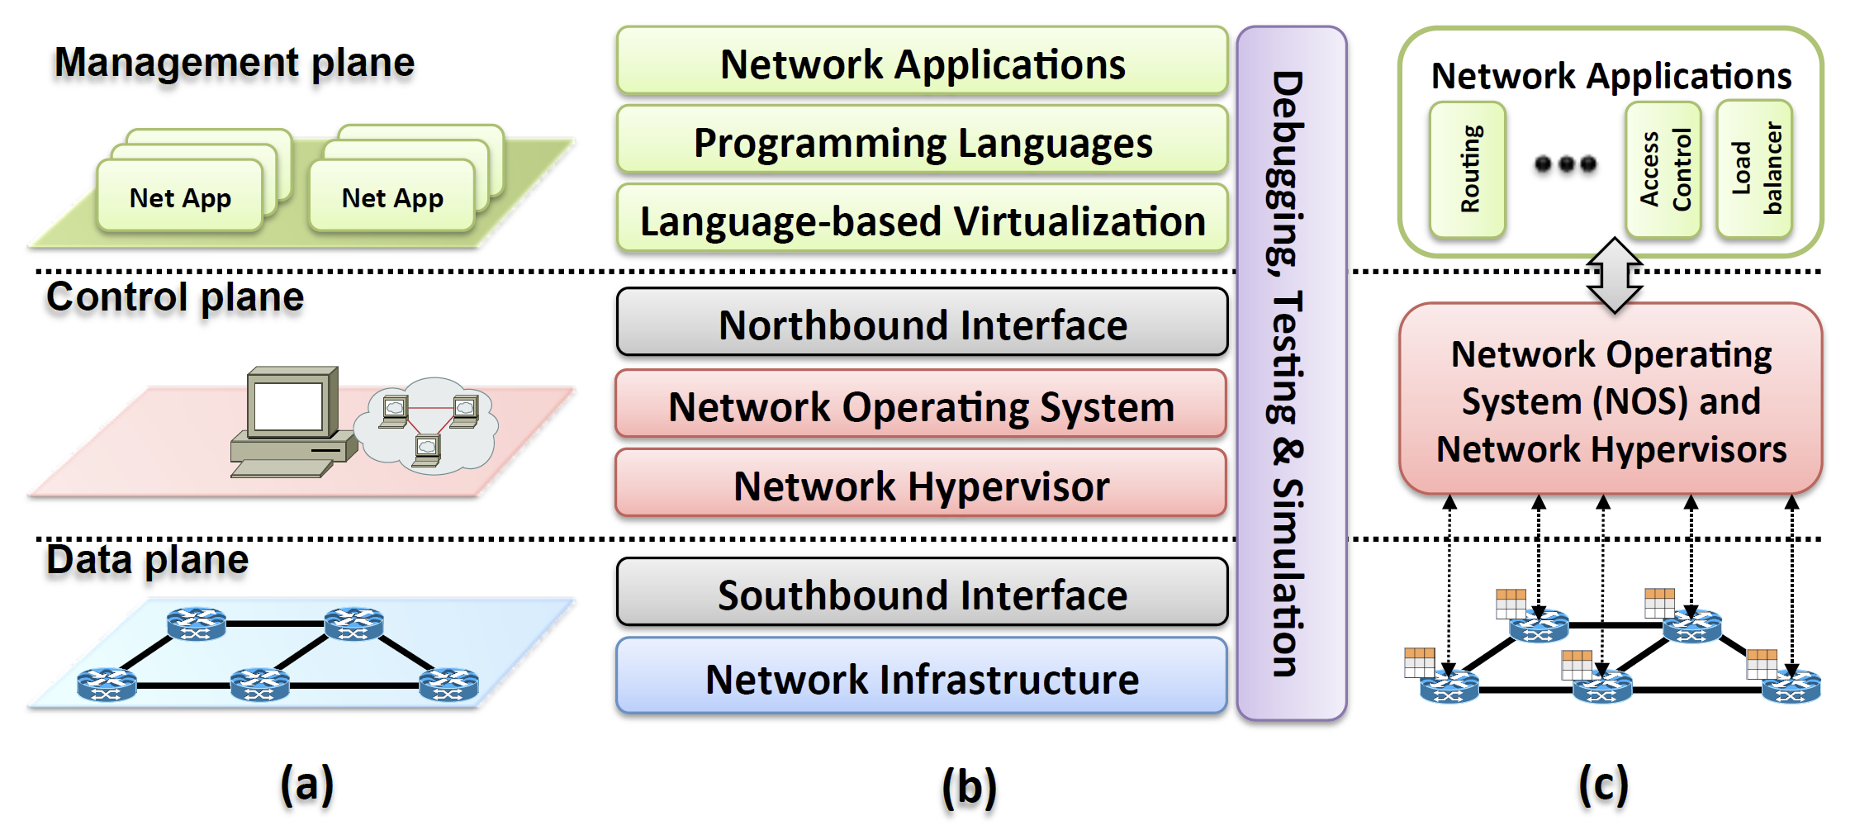
Planes, Layers and Architecture
Software-Defined Networks in (a) planes, (b) layers, and (c) system design architecture

Slide 15
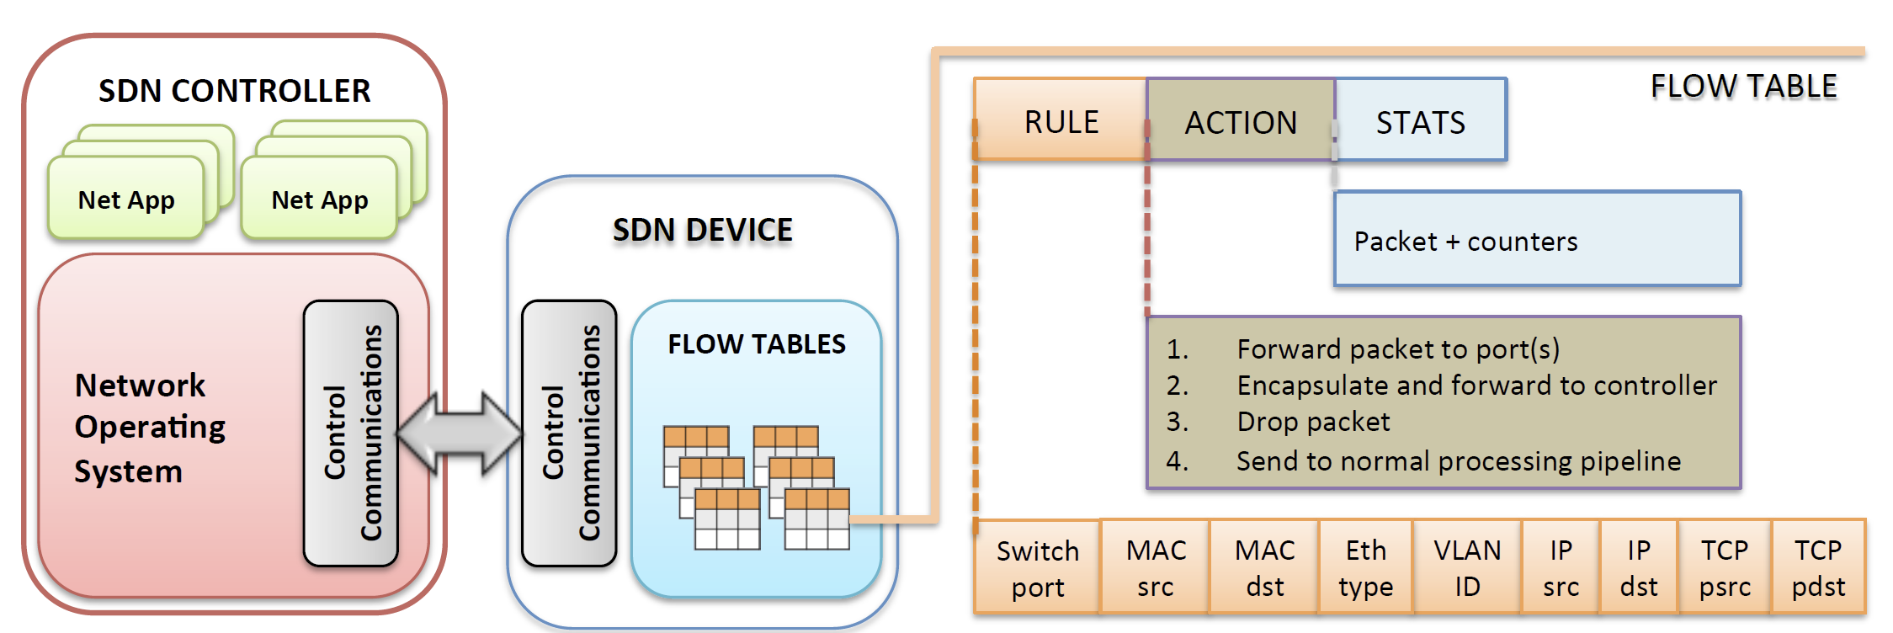
OpenFlow-enabled SDN Devices

Slide 17
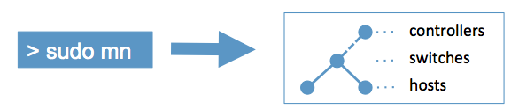
Mininet
https://mininet.org/
Mininet creates a realistic virtual network, running real kernel, switch and application code, on a single machine (VM, cloud or native), in seconds, with a single command:
Mininet is also a great way to develop, share, and experiment with Software-Defined Networking (SDN) systems using OpenFlow and P4.

Slide 18
1. Install mininet on Ubuntu 20.04
https://mininet.org/download/
Use VM.

Slide 19
2. Hello mininet
https://mininet.org/walkthrough/#interact-with-hosts-and-switches
sudo mn
nodes
net
dump
h1 ifconfig -a
s1 ifconfig -a
h1 ping -c 1 h2

Slide 20

Thank You & See You Again

